Slide 1
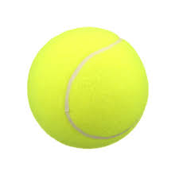
The Tennis Ball Speed Tracker
By: Me (Andrew Pierson)

Slide 2
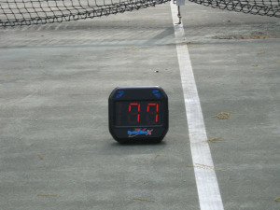
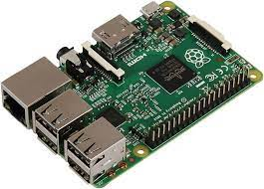
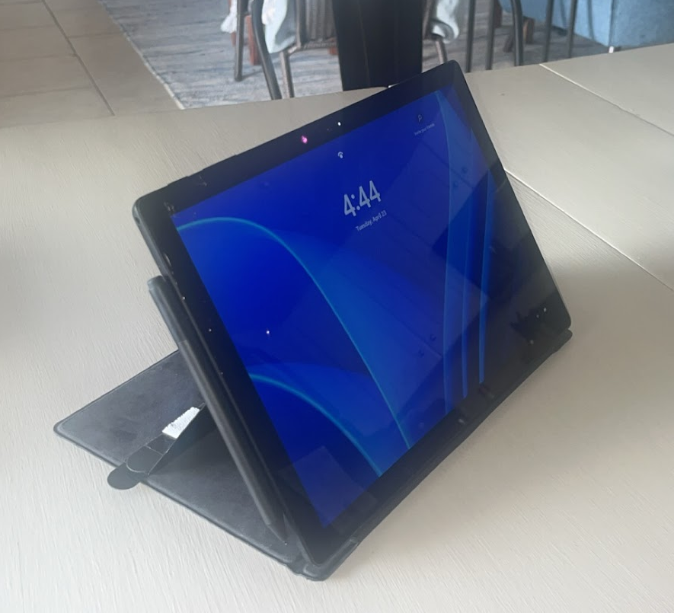
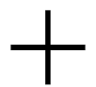
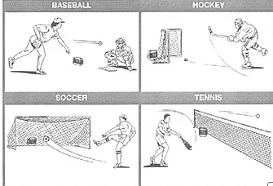
My Tennis Ball Speed Tracker Idea
Example use

Slide 3
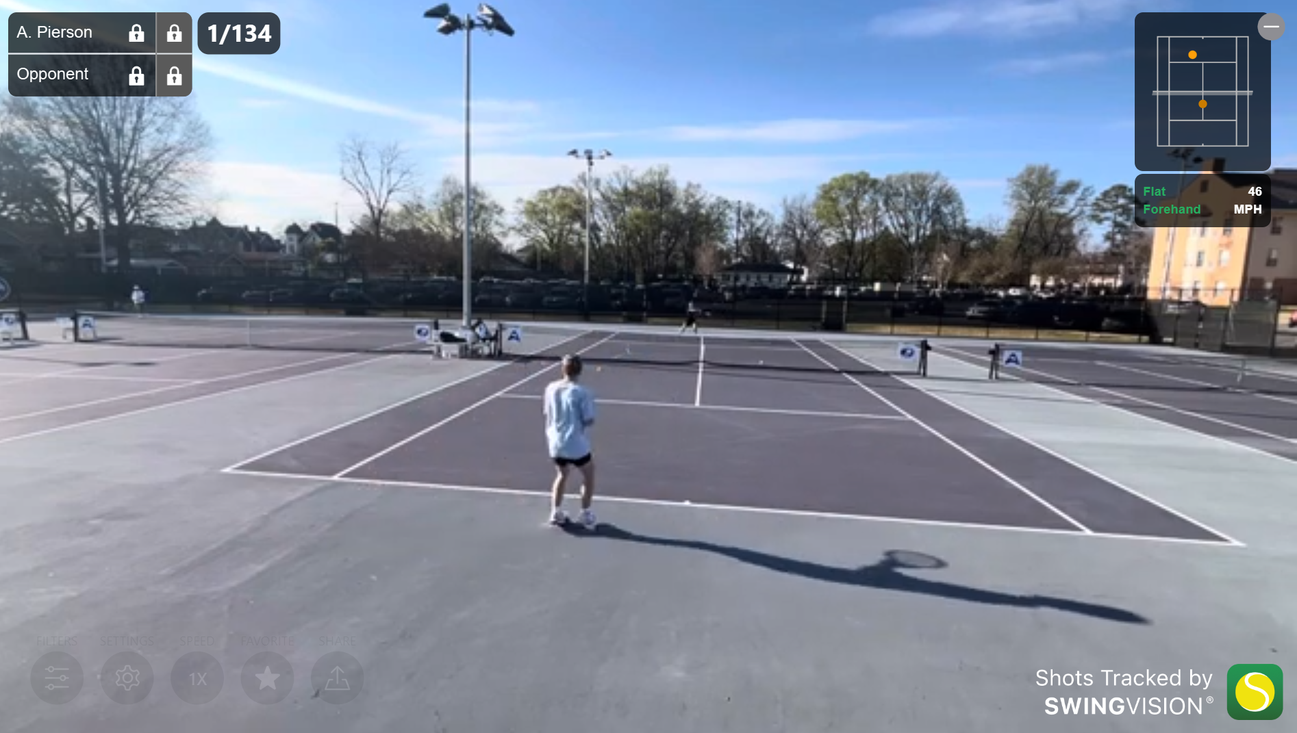
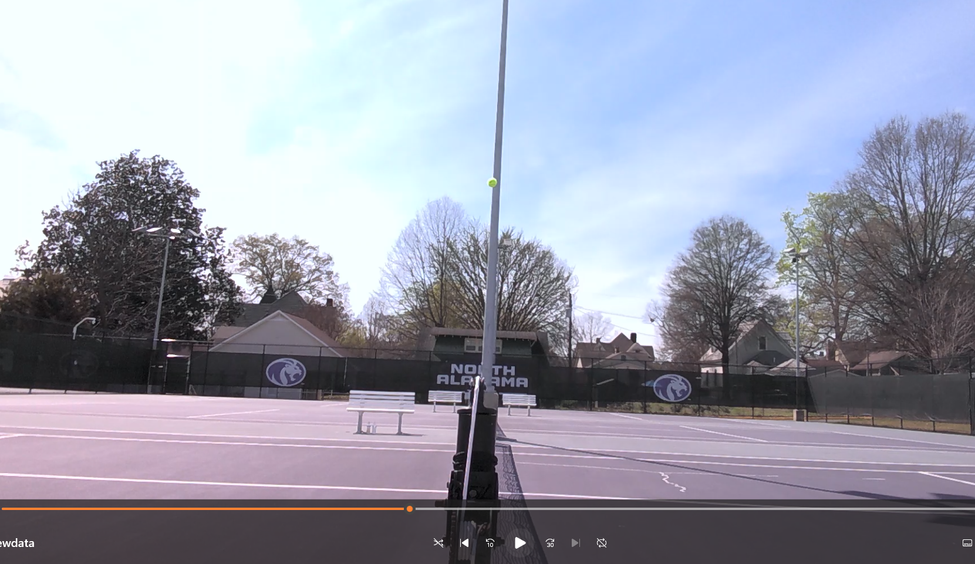
Data Collection: Two videos were recorded to collect speed and displacement data for the model.
Swing Vision App recording
Side View recording
Note: Swing Vision cost $150/year to have an ai subscription.

Slide 4
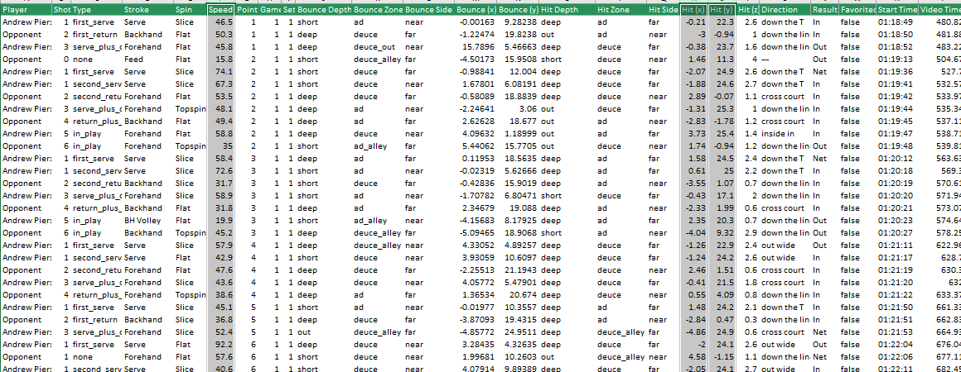
Data collected from Swing Vision:

Slide 5
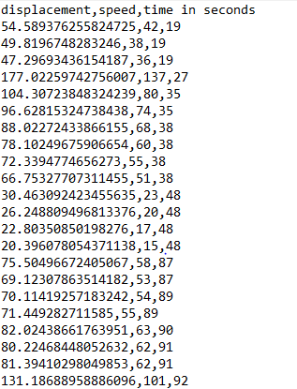
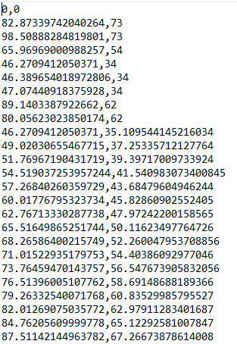
Data collected from the side view:
Data collected
Created training data

Slide 6
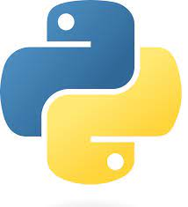
The AI Model: I created a python script that tracks Tennis ball speed using a camera!
*Open the Balltracking.py file*
Explore code
Show a test run!
Compare with Swing vision

Slide 7
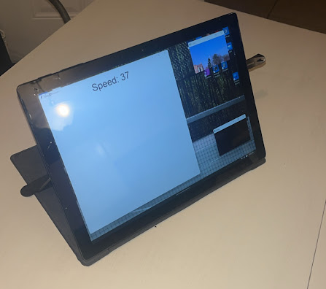

In Conclusion: I created a python model that tracks the speed of the tennis ball, just like my old device did!
-Can be used for any color ball or object-
-predicts speed accurately-
-Easy to use for intended purpose-
-Cheaper than alternatives such as Swing Vision-

Slide 8

Thanks for listening!
A GitHub link will be up shortly after exam time!

Slide 9
Sources:
1. Jonathan Foster’s Code for HSV ball detection.
Link
2. Linear regression- Doctor Mark Terwilliger's lesson 9 code
Link
3. Stack Overflow- for zoom in feature for code.
Link

